Slide 1

Module 4 Unity 2D Basics and Selection

Slide 2
Learning Objectives
Use the Unity Editor to add sprites and game objects to a game
Use the Unity Editor to modify game object characteristics in the Inspector
Describe how Unity's component system works
Create scripts and attach them to game objects to implement game object behavior
Use the Physics 2D system from within scripts to move game objects
Modify game objects to include colliders to support collision detection and resolution
Build and use prefabs in a Unity game
Develop C# code that makes decisions using the if statement
Develop C# code that makes decisions using the switch statement

Slide 3
Content (slot 1)
The Worst Game EVER
A Better Not A Game
Exercise 10
Exercise 11
Prefabs
Unity Circles Revisited

Slide 4
4.1 The Worst Game EVER
Start up Unity Hub, make sure Projects is selected on the left.
Click New near the upper right corner
Select the 2D template on the left, set a Project Name and Location for your project, then click the Create button on the lower right.
When the Unity editor starts up, use the layout dropdown near the upper right to set the layout to the one you want to use.
Rename the default SampleScene to scene0 and save it.
Click the play button in the middle near the top (or Ctrl+P). What happen?
Click the Maximize on Play option at the top right of the Game view and play the game again. What happen?

Slide 5
4.1 The Worst Game EVER
Why?
Because there's no player interaction with the game world, and that's what games are all about!
To have player interaction we need to use Unity's input capabilities (covered in Chapter 8).
We can start learning about how Unity works in this chapter by providing some interesting graphical output in our game.

Slide 6
4.2 A Better Not A Game (NAG)
Create a new Unity 2D project, rename the default scene and save it.
Right click on the Assets folder in the Project window and create another new folder called Sprites.
Now go to your operating system and copy the teddy bear png files from the code for this chapter into the Sprites folder (which you'll find under the Assets folder wherever you saved your new Unity project).
When you copy the png files into the Sprites folder, Unity automatically imports them as sprites in your project.

Slide 7
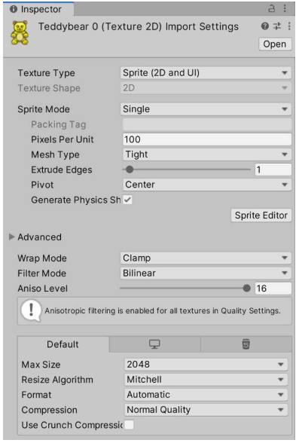
4.2 A Better Not A Game (NAG)
teddybear0 Import Settings

Slide 8
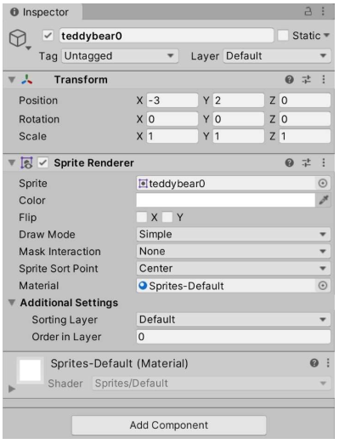
4.2 A Better Not A Game (NAG)
Inspector for Teddy Bear 0 Game Object

Slide 9
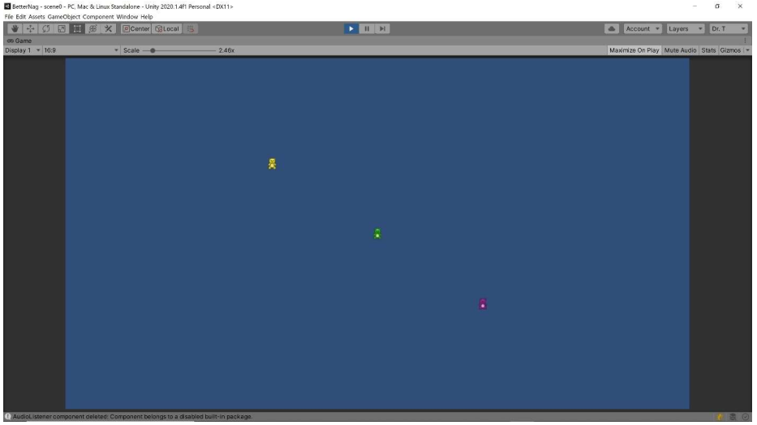
4.2 A Better Not A Game (NAG)
Initial Teddy Bear Output

Slide 10
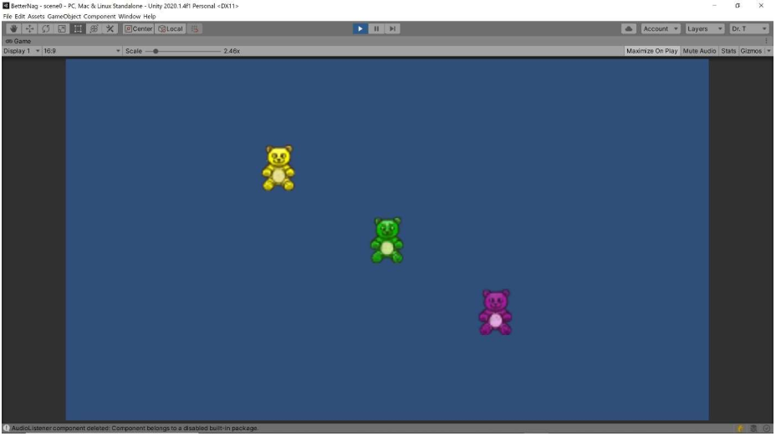
4.2 A Better Not A Game (NAG)
Teddy Bear Output with Modified Pixels per Unit

Slide 11
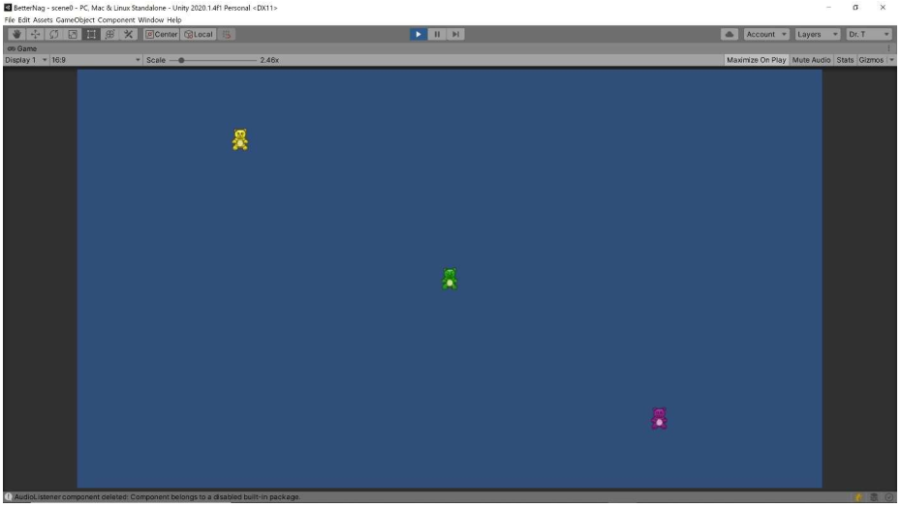
4.2 A Better Not A Game (NAG)
Teddy Bear Output with Smaller Camera Size

Slide 12
Exercise 10: Unity Basics
Problem 1 - Create a Unity project and add sprites
Create a new 2D Unity project named Exercise10. Add a scenes folder to the Project window and save the current scene as scene0. Add a sprites folder to the Project window and use your OS to add any three sprites you want to that folder (I suggest you use png files, though Unity supports other file formats as well).
Problem 2 - Add sprites to scene
Drag each of the sprites from the sprites folder in the Project window onto the Hierarchy window.
Adjust the Position X and Y values in the Transform component to place the new game objects in the scene in a reasonable way.
Problem 3 - Run the game
Click the arrow facing to the right (the Play button) near the top center of the Unity Editor and check out your amazing game in the Game view!

Slide 13
Exercise 11: Growing Teddies
Link: LMS

Slide 14
4.3 Prefabs
A template for creating as many instances of a game object, including all its properties and components.
Walk through the process of creating and using prefabs to refactor the game from the previous section to use prefabs instead.
Our starting point for our solution in this section is our solution from the previous section with only the first teddy bear placed in the scene.

Slide 15
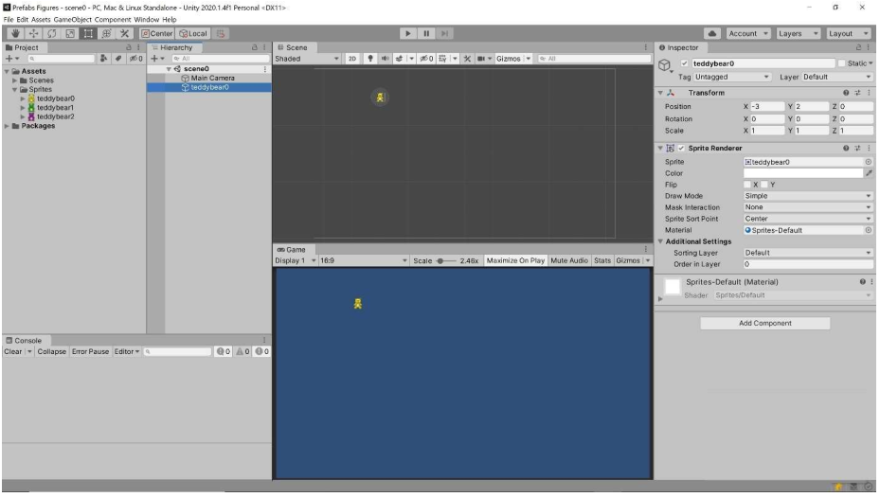
4.3 Prefabs
Prefab Starting Point

Slide 16
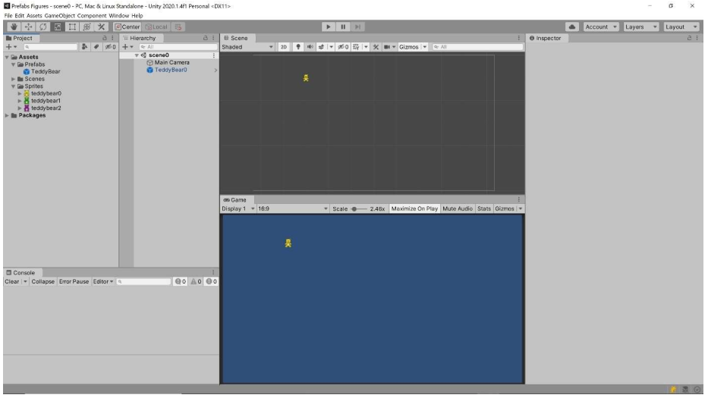
4.3 Prefabs
TeddyBear Prefab Created

Slide 17
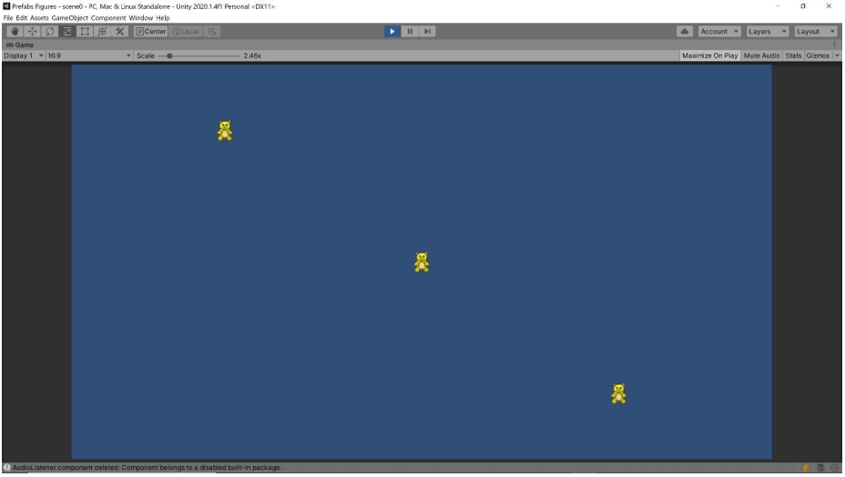
4.3 Prefabs
Three TeddyBear Instances

Slide 18
4.4 Unity Circles Revisited
The problem description:
Calculate the area of the circles with integer radii from 0 to 5, then print out the radius and area for each circle.

Slide 19
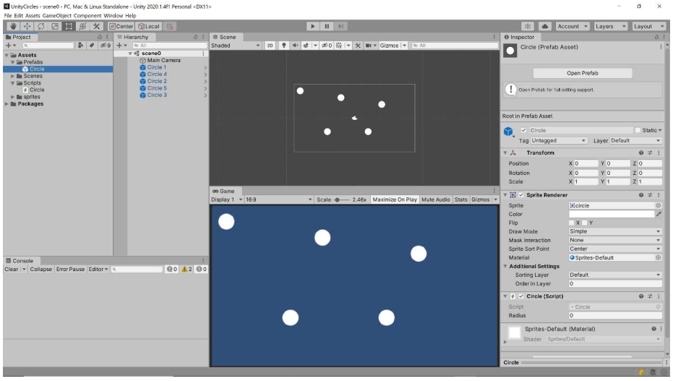
4.4 Unity Circles Revisited
Circle Prefab

Slide 20
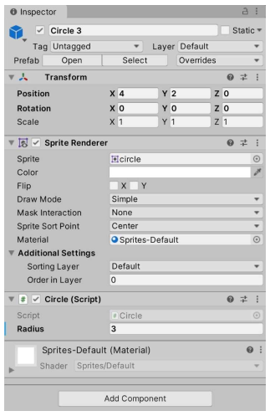
4.4 Unity Circles Revisited
Circle 3 Game Object

